Slide 1
DX University
Hartford, CT – 2014

Slide 2
Station & Antenna Considerations
Joe Reisert W1JR

Slide 3
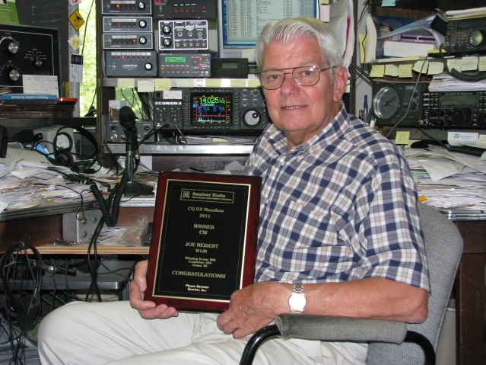
Joe Reisert W1JR
First licensed in 1951 as WN2HQL and has been a serious DXer since 1954.
Top of the DXCC Honor Roll with 391/340 total, DXCC Challenge 3148, Satellite DXCC, and 11-band DXCC (160 through 6 meters including 60 Meters).
DXpeditions in 1957 as W2HQL/KC4 (Navassa I.) and as VP2VB in 1958 with Danny Weil.
Member of the YCCC Contest Club. Life member of ARRL and AMSAT. Over 135 published articles. DX Hall of Fame (2014)

Slide 4
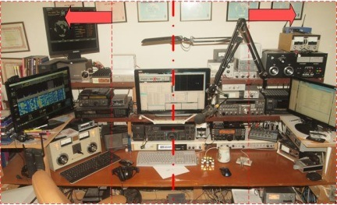
Topics
Radios
Antennas
Other Station Elements
Station Layout

Slide 5
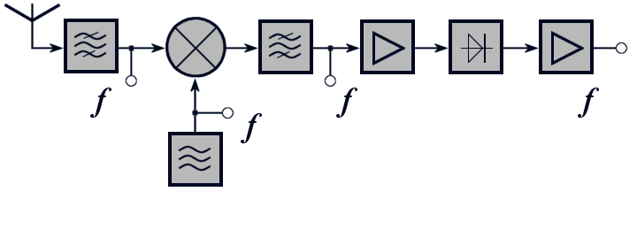
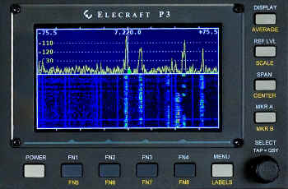
Radio Equipment - Receivers
Critical receiver requirement
Sensitivity
Selectivity
Dynamic range
Split frequency operation
Advanced capability
Second receiver or sub-receiver
Diversity reception. External RX ant.
Panadapter displays
Software Defined Radios (SDR)
~

Slide 6
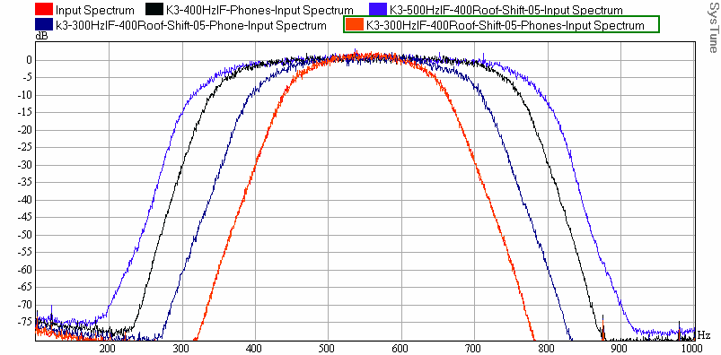
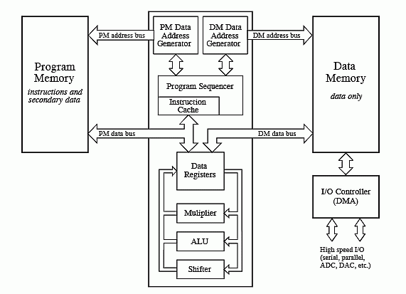
Receiver Selectivity
Roofing Filters
Limits power applied to non-linear receiver elements
Digital Signal Processing
Bandpass filters
Bandpass tuning.
Notch filters
Noise Reduction algorithms
Noise Blanking

Slide 7
Receiver Dynamic Range
One simple definition: Blocking Dynamic Range
Copy a weak signal simultaneously with a high level, off-channel signal
Ratio of signal amplitudes at point when degradation of weak signal starts
Radio | BDR, dB
Elecraft K3 | 139
Ten Tec Orion II | 136
Yaesu FTdx9000D | 127
ICOM IC-7800 | 115
ICOM IC-756PROIII | 101

Slide 8
Transmitter - Critical Requirements
Power level
Heat is at the root of most component failures
Consider operating radios well below maximum power levels
Output power and VSWR meter
Quality – How good (or wide) is your signal?
Undesirable sidebands – clicks or phase noise will get you noticed
Reduce audio distortion; audio processing may result in higher average power but can result in lower intelligibility.
Consider covering all the operating modes
Traditional modes (CW, SSB, AM, RTTY) are native
New modes (e.g. PSK31, JT65) may require external modems

Slide 9
Antennas and Transmission Lines
General characteristics (Ref. 2)
Antennas are the best investment in your station
Efficient antennas are likely to be narrowband
Reliability can be as important as performance
Requirements related to effective DXing
Higher antennas work DX better than lower ones
Pattern matching propagation path to DX (Ref. 1)
Pattern reducing effects of interference
Transmission line losses (Ref. 2)
Baluns and chokes (Ref. 5, 7 & 8)

Slide 10
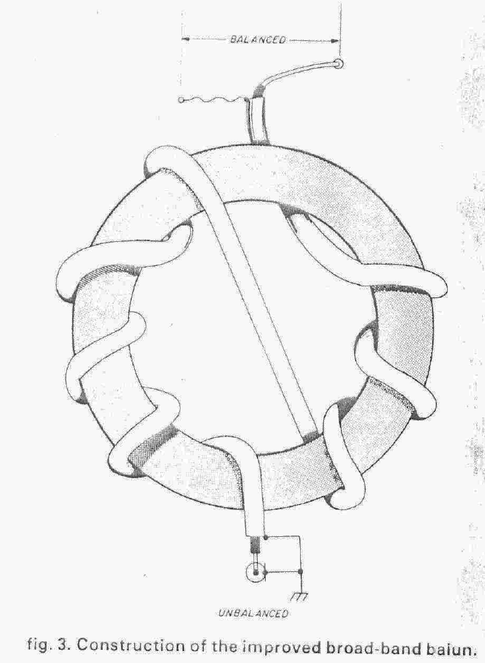
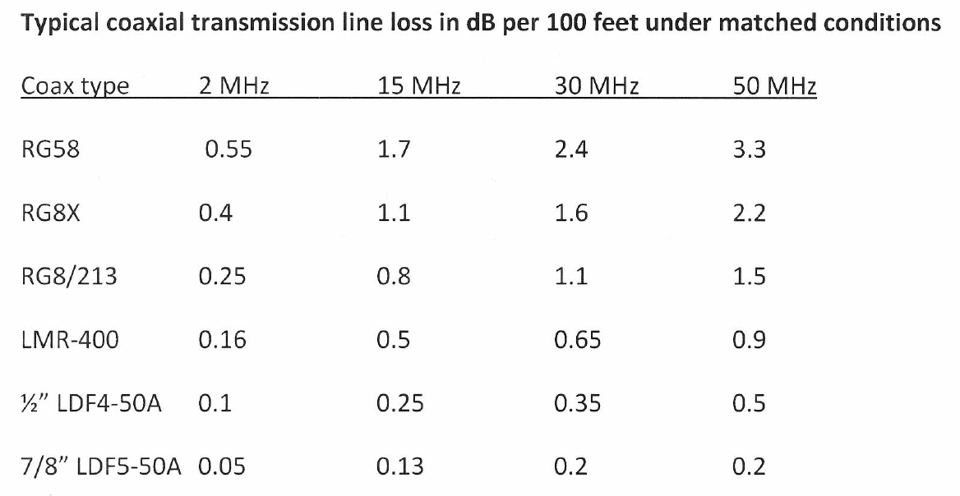
Transmission line losses and Baluns

Slide 11
Antennas - HF
Monoband antennas (Ref. 2)
Dipoles/Loops
Verticals
Full size: Yagi^{1 (Ref. 3)}
Shortened: Moxon²
1
2

Slide 12
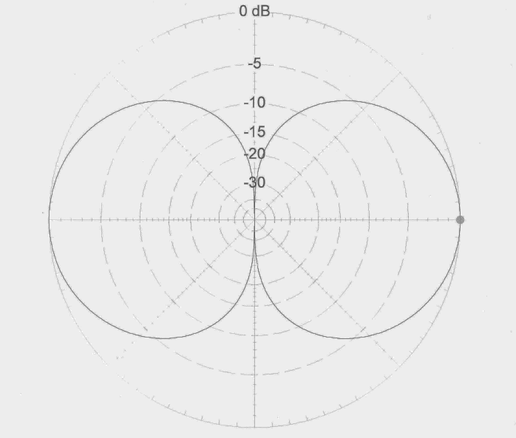
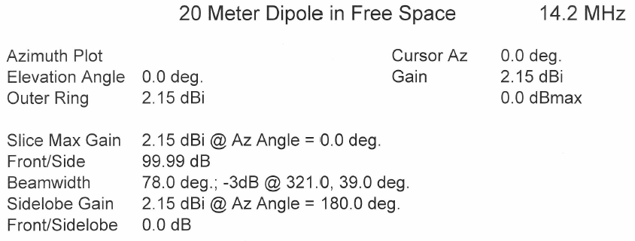
Antennas - HF

Slide 13
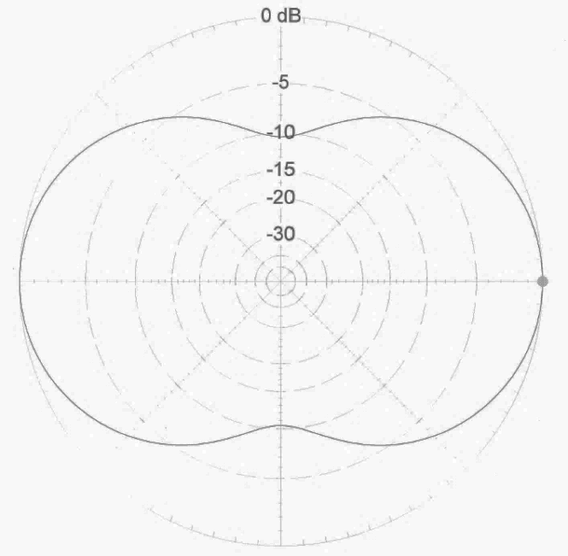
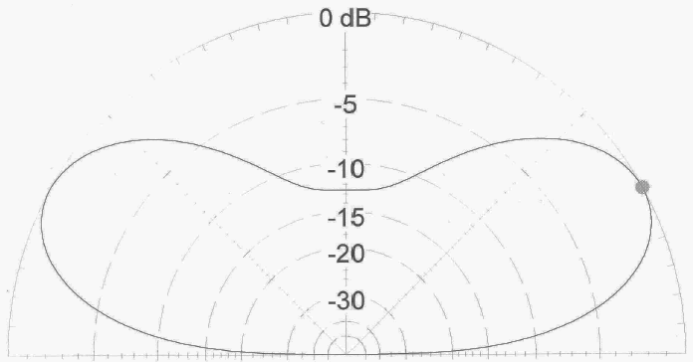
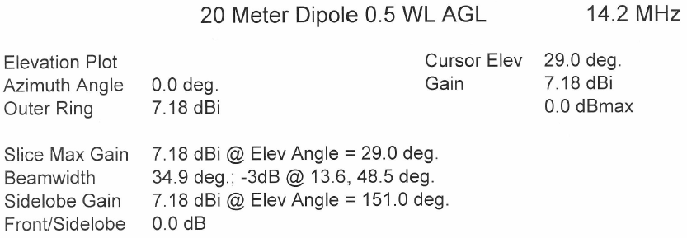
Antennas - HF

Slide 14
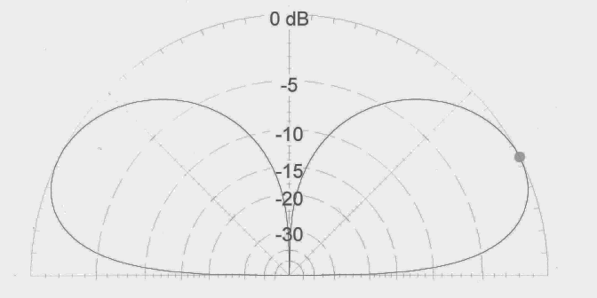
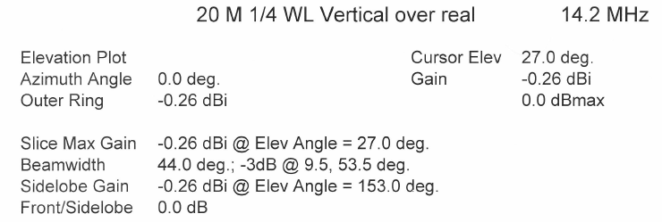
Antennas - HF

Slide 15
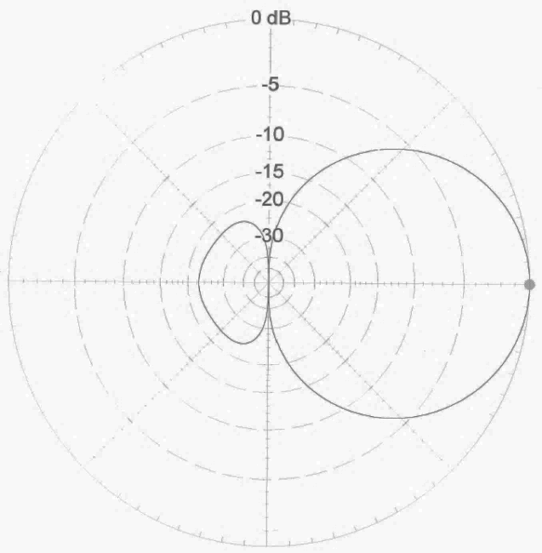
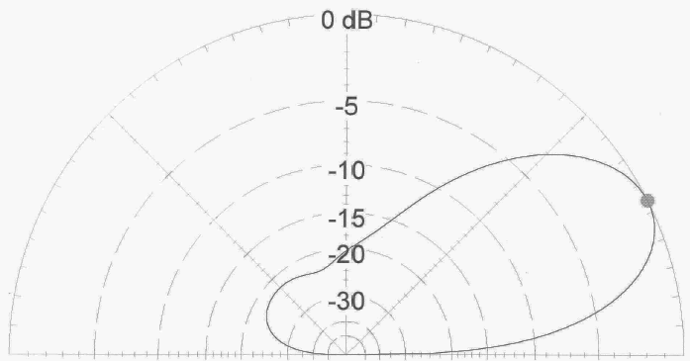
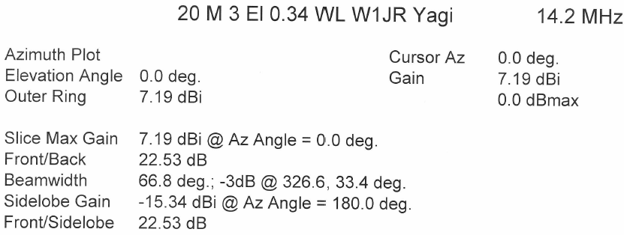
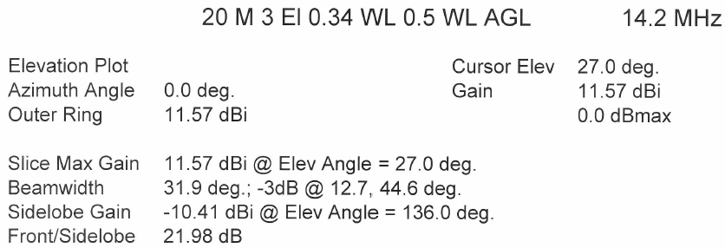
Antennas - HF

Slide 16
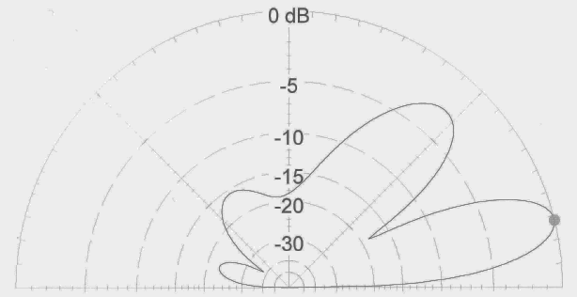
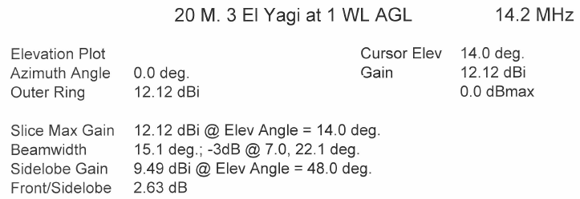
Antennas - HF

Slide 17
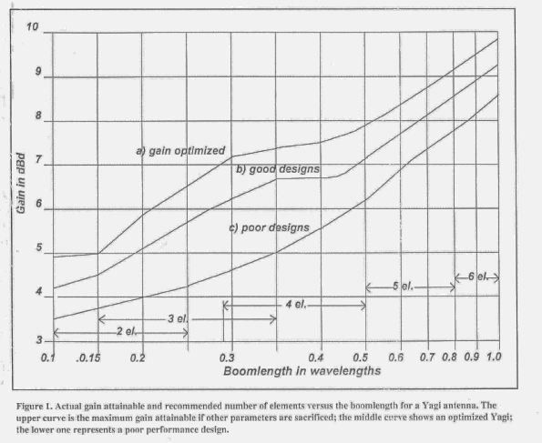
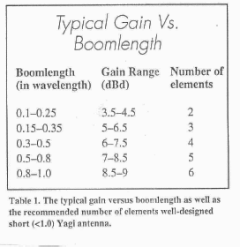
Antennas - HF

Slide 18
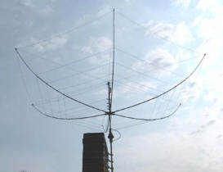
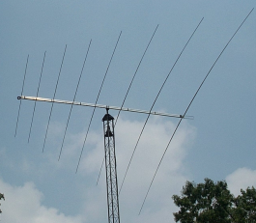
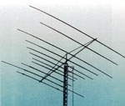
Antennas - HF
Multi-band antennas (Fixed)
Hexbeam¹
Spider beam²
Log periodic³
Quad⁴
Multiband Yagi⁵
1
2
3
4
5

Slide 19
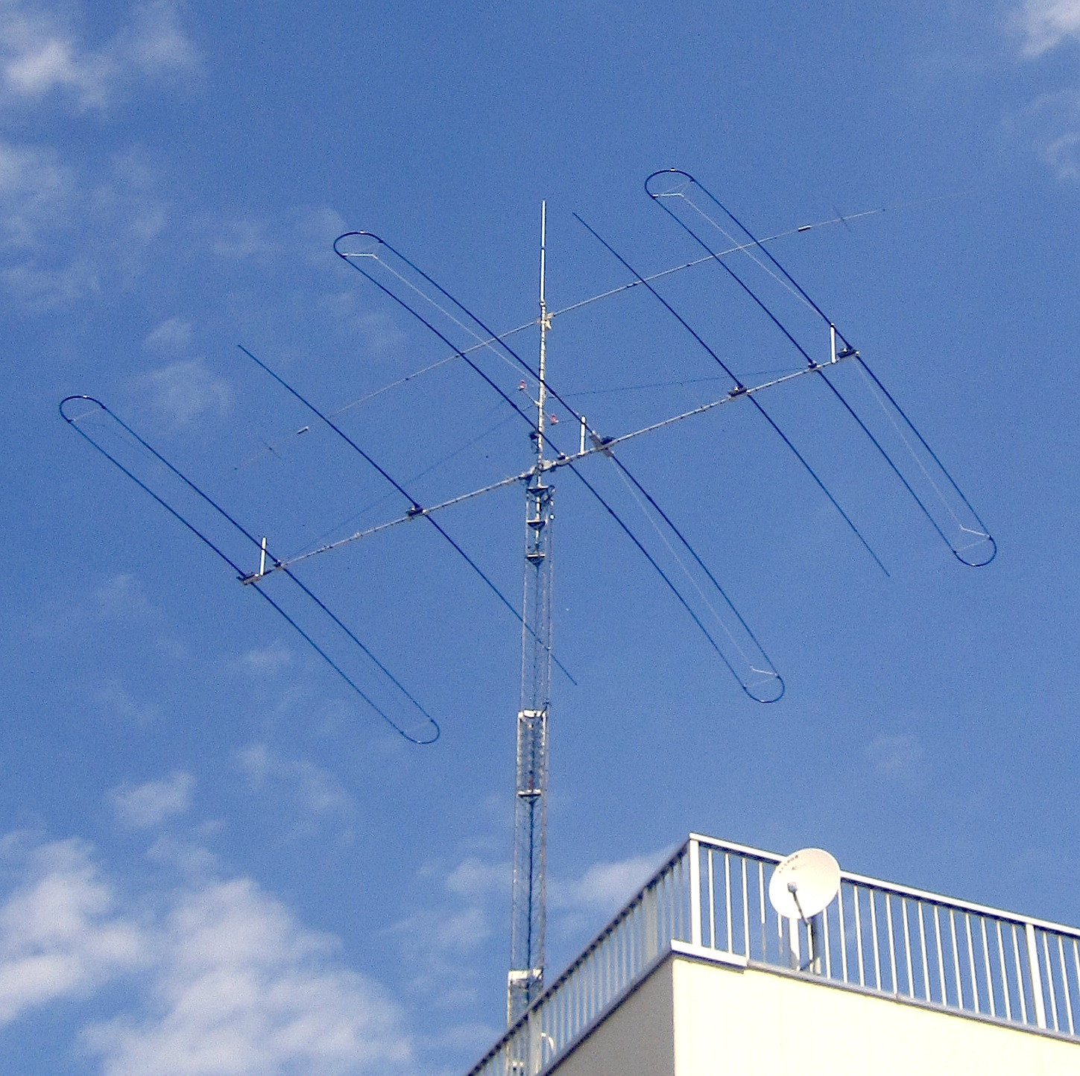
Antennas - HF
Adjustable
SteppIR
Many frequencies
Optimum performance

Slide 20
Low frequency antennas (160, 80 & 40 m)
Transmit antennas (Ref. 4)
Dipoles/Loops (as high as possible)
Inverted “V” Dipoles
Verticals with many radials (Ref. 6)
Inverted “L”
Loaded Towers

Slide 21
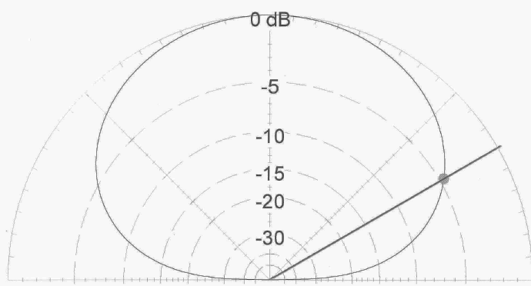
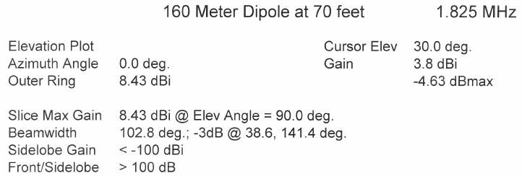
Antennas – Low Frequency (160, 80 & 40)

Slide 22
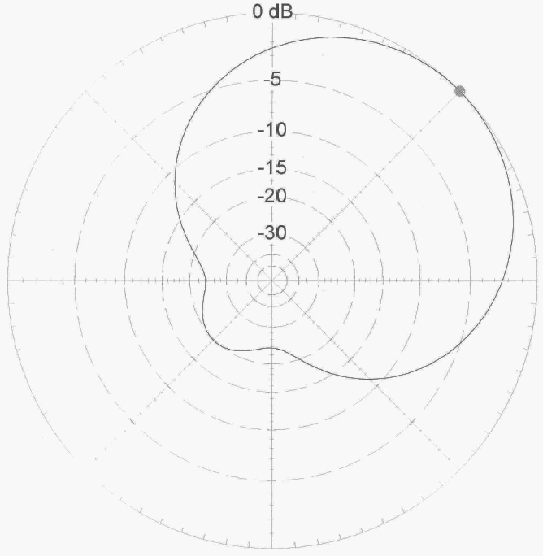
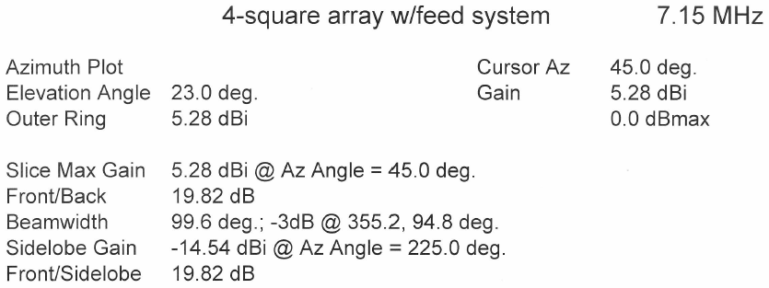
Antennas – Low Frequency (160, 80 & 40)

Slide 23
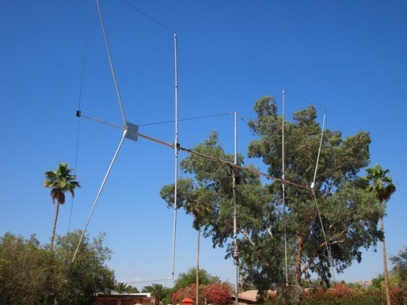
Low frequency antennas (160 & 80 m)
Receive antennas (Ref. 4)
Beverages (Ref. 5)
Loops (ground-dependent antennas)
Flag/pennants (ground-independent antennas)
3, 4 & 8 Element short vertical arrays
Front end protectors

Slide 24
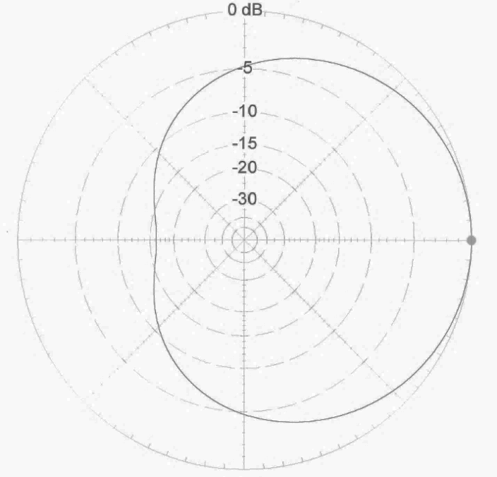
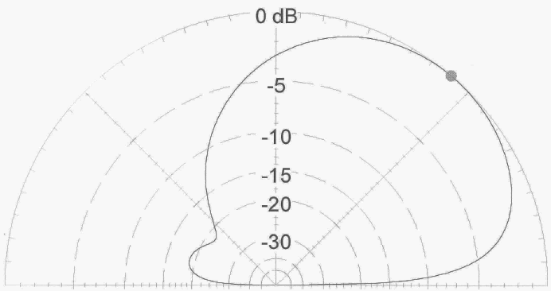
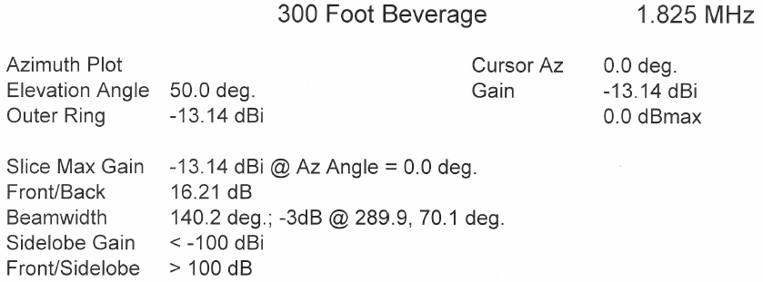
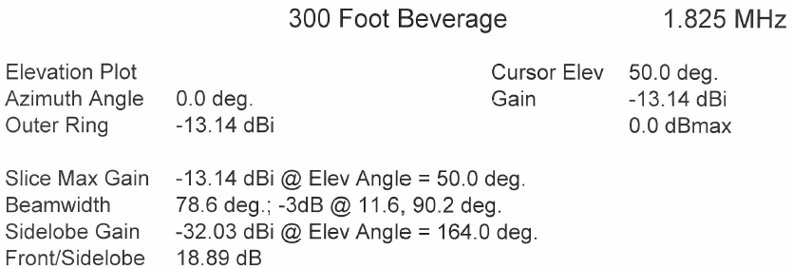
Antennas – LF Receiving Antennas

Slide 25
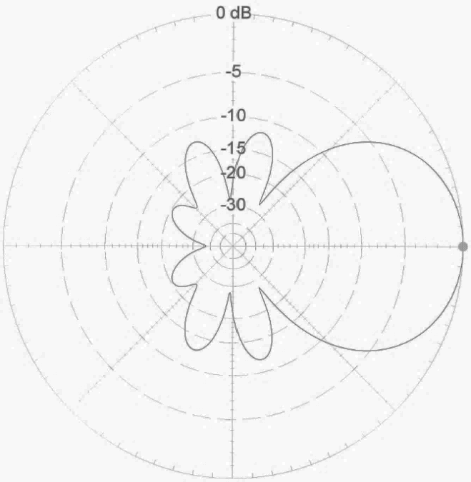
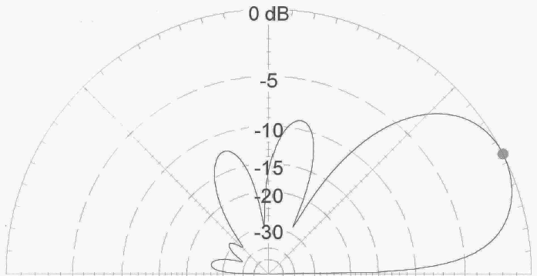
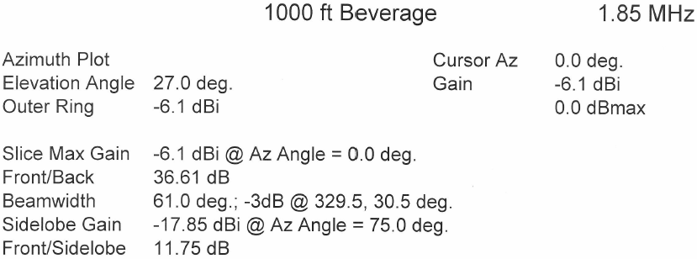
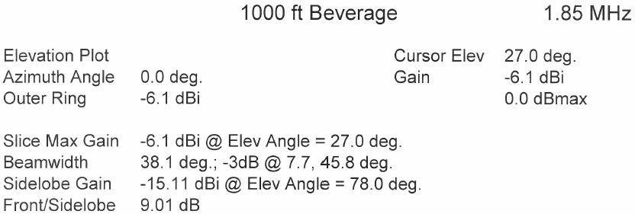
Antennas – LF Receiving Antennas

Slide 26
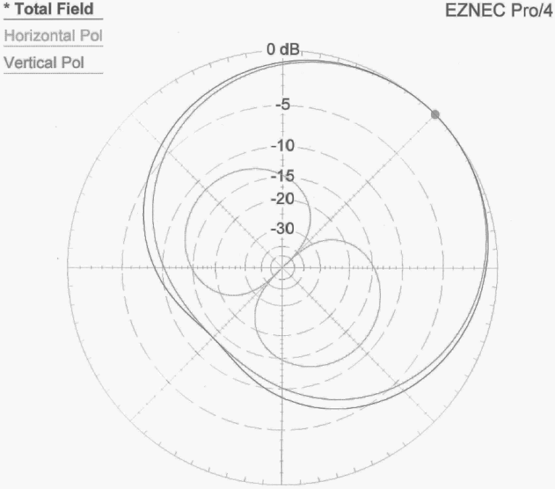
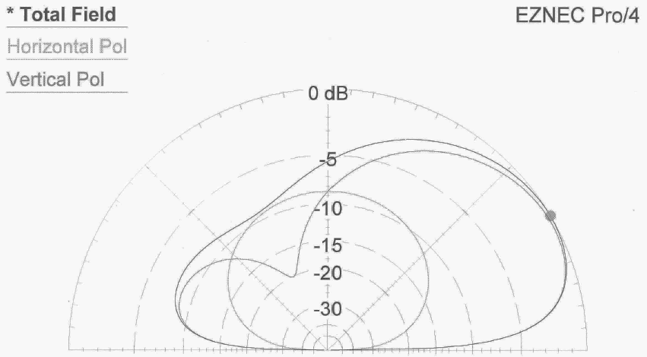
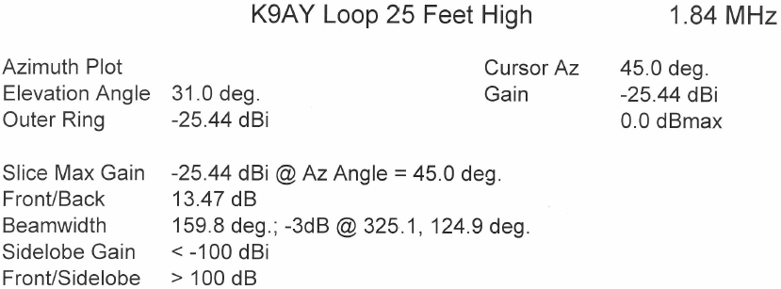
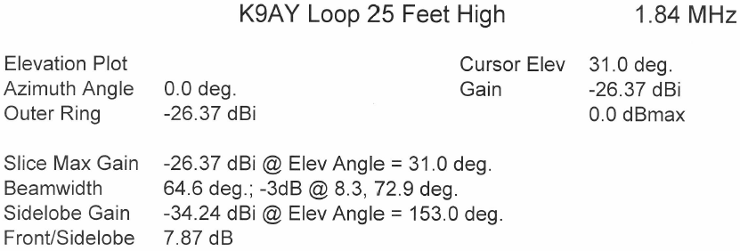
Antennas – LF Receiving Antennas

Slide 27
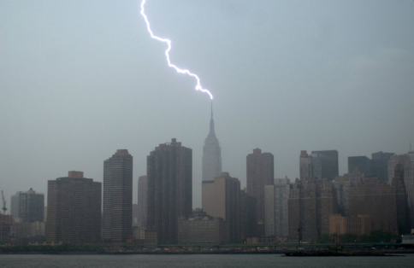
Other Station Elements
Grounding
Grounding towers and antennas
Nearby lightning strike protection
Shock hazard mitigation
Audio ground loop reduction

Slide 28
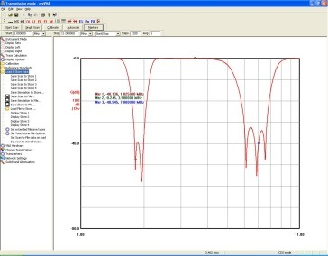
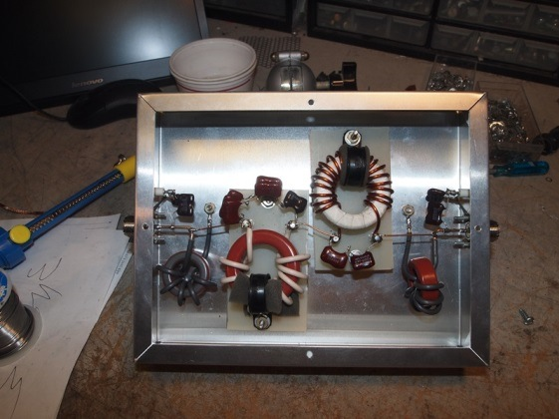
Other Station Elements
Filtering
Harmonic suppression
BCI reduction
Protection of local equipment

Slide 29
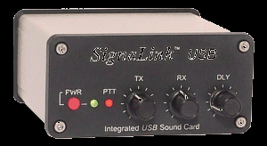
Other Station Elements
Audio Transducers
Headphones / speakers
Microphones
PC CODECs

Slide 30
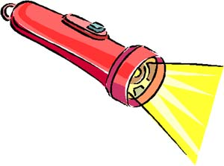
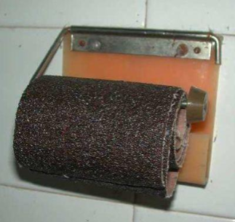
Station Layout Considerations
Reduce stress and strain
Organization of equipment
Neck strain reduction
Minimize eye strain
Lighting
Must see the radio knobs
Must see keyboards
Ambient sound
Fan noise
Clunking relays
Posterior comfort

Slide 31
AA7A Station – 10 Feb 2012 (at 1646 Z )
Rotor Display
HF Radio #1
HF SDR #3
HF Amplifier #2
SDR Display
HF Radio #2
HF Logging Computer mon #2
HF Logging Computer mon #1
HF Amplifier #1
12-channel Audio Mixer
HF Wattmeter
HF Amplifier #3

Slide 32
AA7A Station – Operator Focus
Secondary Focus
Primary Focus
Secondary Focus

Slide 33
Summary
1. Know your station and its capabilities.
2. Pay attention to the layout of your operating position.
3. The antenna is the most important part of you station.
4. Keep transmission line losses to a minimum.
5. Protect your station from electrical discharge.
Happy Hunting
Notes:
Summary

Slide 34
DXU References
Dean Straw, N6BV Propagation Charts
The ARRL Antenna Book
Yagi/Uda Design, Part 1: A Different approach, Joe Reisert, W1JR, PP-49-59, Communications Quarterly, Winter 1998
Low-Band DXing, 5th Edition, John Devoldere, ON4UN
Simple and Efficient Broadband Balun, Joe Reisert, W1JR, Ham Radio Magazine, September 1978, pg 12
N6LF website: (http://www.antennasbyn6lf.com/)
W1HIS website: (http://www.yccc.org/Articles/W1HIS/CommonModeChokesW1HIS2006Apr06.pdf)
K9YC website: (http://audiosystemsgroup.com/RFI-Ham.pdf)
Many thanks to Ned Stearns, AA7A for his original presentation of this material and his assistance in updating the material.
Joe Reisert, W1JR, revised 26 June, 2014

Slide 35
Notes:
Station and Antenna Considerations

